Slide 1
Shell Bootcamp 2024 3 Reflections for Week #<1>
<Harsh Verma>
Date : 30-Aug-2024

Slide 2
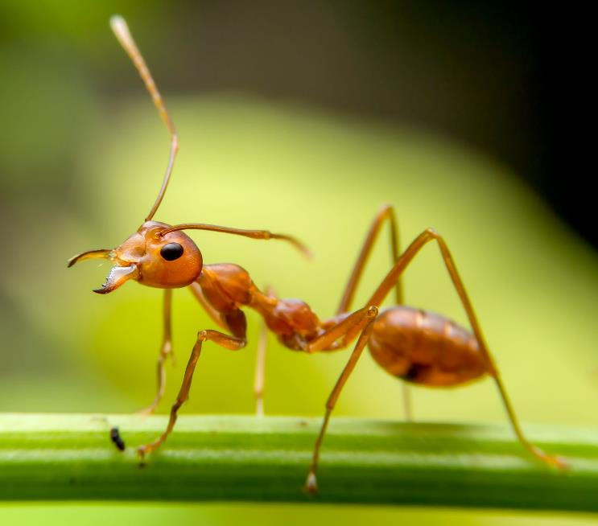
About Me
"Small steps, big impact—together I thrive."
This phrase highlights how individual efforts, much like an ant’s, can lead to significant results when driven by purpose and collaboration.
Please share an image / visual that best represents you

Slide 3

My learnings from this week!

Slide 4
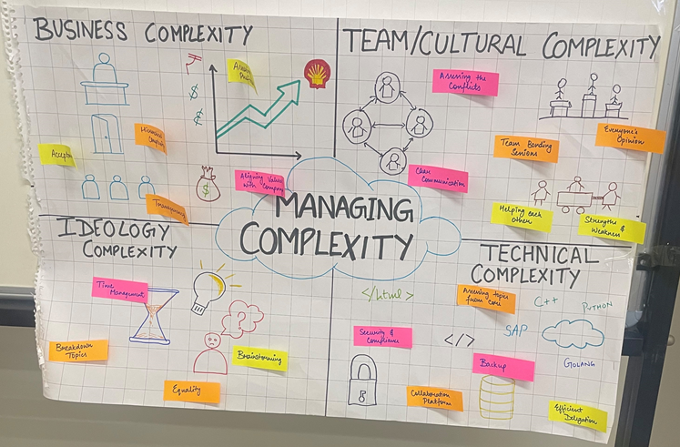
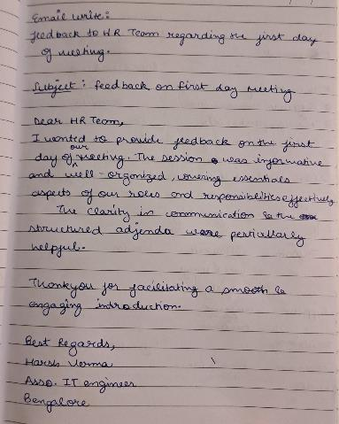
Learning 1 | My takeaways (SOFT SKILLS - DAY 1)
Professional Behavior: Uphold integrity, reliability, and respect while communicating clearly and being accountable.
Growth Mindset: Embrace challenges, learn from feedback, and persist through setbacks to continuously grow.
Grooming: Maintain cleanliness and appropriate attire to reflect professionalism and self-respect.
Etiquette for Calls and Chats: Be clear, courteous, and professional in all forms of communication.
Email Writing for Feedback: Provide specific, constructive, and respectful feedback in a clear tone.

Slide 5
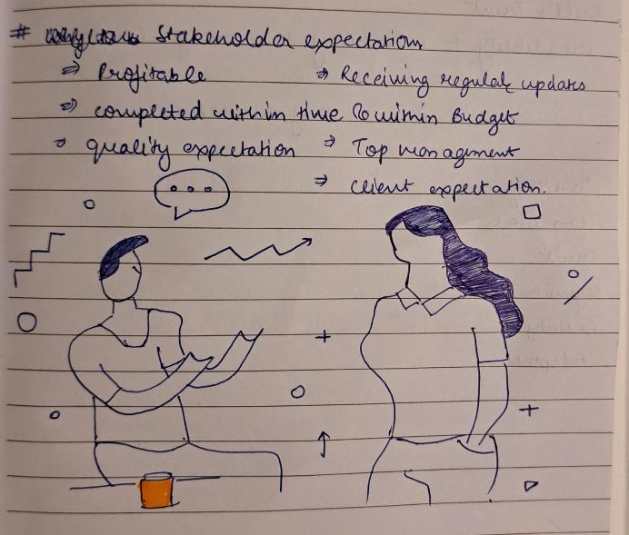
Learning 2 | My takeaways (SOFT SKILLS - DAY 2)
Stakeholder Identification & Analysis: Identify key stakeholders and assess their interests and influence.
Effective Communication Strategies: Tailor communication to address stakeholders' needs and preferences.
Managing Stakeholder Expectations & Conflicts: Align expectations and address conflicts through proactive and transparent engagement.
Building and Managing Stakeholder Relationships: Foster strong, ongoing relationships through consistent and respectful interactions.

Slide 6
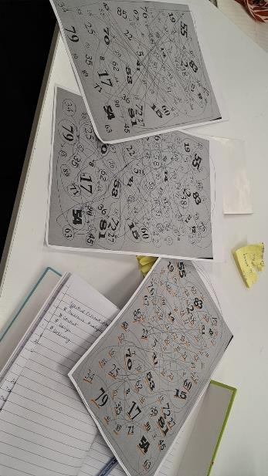
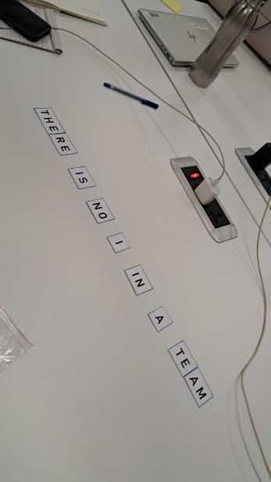
Learning 3 | My takeaways (SOFT SKILLS - DAY 3)
Teamwork: Collaborate effectively to achieve common goals and enhance productivity.
Working in Teams: Leverage diverse skills and perspectives for better outcomes.
Stages in Team Development: Recognize and navigate the phases of team growth: forming, storming, norming, performing, and adjourning.
Traits of a Team Player: Exhibit reliability, communication, and cooperation to contribute to team success.
Growth Mindset: Embrace challenges and view feedback as opportunities for personal and team development.
Giving and Receiving Feedback: Provide constructive feedback and accept it graciously to foster continuous improvement.
Follow-Up and Status Update: Regularly update on progress and follow up to ensure alignment and address issues.
Working in Hybrid Teams: Adapt to both in-person and remote team dynamics to maintain collaboration and productivity.

Slide 7

Relevance of learnings for my organization

Slide 8
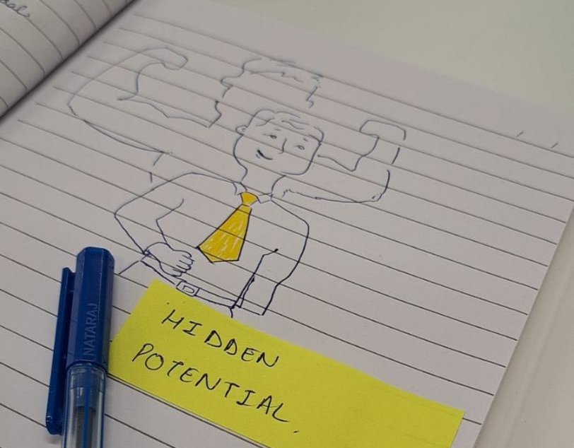
Learning 1 | Relevance for Shell
How I feel Shell implements this learning Shell integrates clear communication and feedback, supports structured team development, promotes a growth mindset, and adapts to hybrid work environments.
How I feel Shell benefits from this learning These practices enhance team collaboration, improve stakeholder relationships, drive continuous innovation, and ensure productivity in diverse work settings.
[Add a graphic that provides view of how Shell implements this learning]

Slide 9
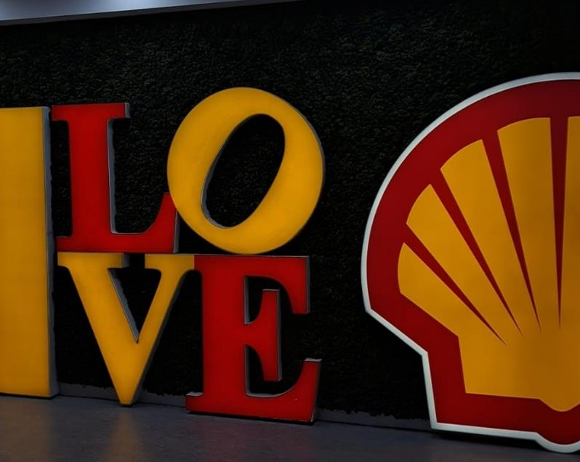
Learning 2 | Relevance for Shell
How I feel Shell implements this learning
Shell applies these principles by ensuring effective communication, structured team development, and adaptability in hybrid work settings.
How I feel Shell benefits from this learning
This approach boosts team collaboration, strengthens stakeholder relationships, and enhances productivity and innovation.
[Add a graphic that provides view of how Shell implements this learning]

Slide 10
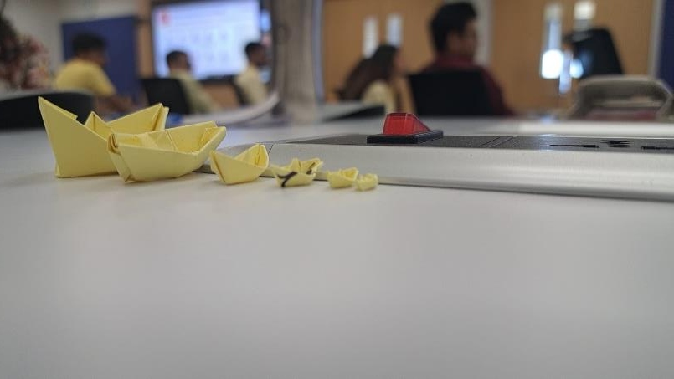
Learning 3 | Relevance for Shell
How I feel Shell implements this learning
Shell applies clear communication, structured team development, and effective hybrid work strategies.
How I feel Shell benefits from this learning
These practices enhance team cohesion, improve stakeholder engagement, and drive higher productivity and innovation.
[Add a graphic that provides view of how Shell implements this learning]

Slide 11

Challenges in implementing learning

Slide 12
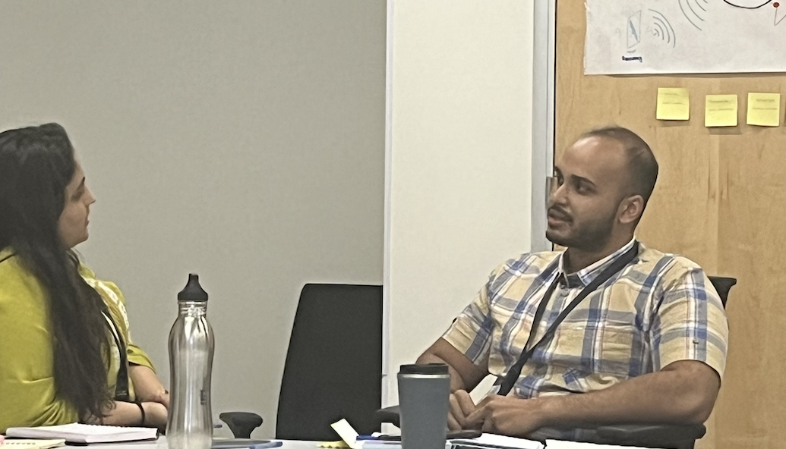
Challenge faced while implementing Learning 1
What were the challenges I faced while implementing Learning 1 and my plan to overcome them
Challenges: Difficulty in aligning stakeholder interests and communication preferences.
Plan: Develop a comprehensive stakeholder communication plan and use feedback tools to adjust strategies.
[Add a graphic that provides evidence of what you did to overcome this challenge]

Slide 13
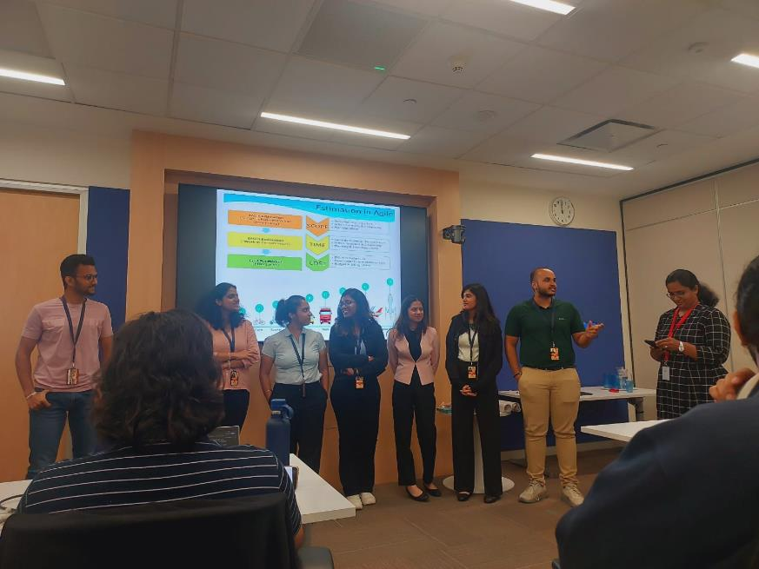
Challenge faced while implementing Learning 2
What were the challenges I faced while implementing Learning 2 and my plan to overcome them
Challenges: Managing diverse team dynamics and maintaining consistent engagement in hybrid settings.
Plan: Implement regular check-ins, use collaborative tools for streamlined communication, conduct role-playing exercises to simulate stakeholder interactions, and provide templates for mapping strategies to apply learnings effectively.
[Add a graphic that provides evidence of what you did to overcome this challenge]

Slide 14
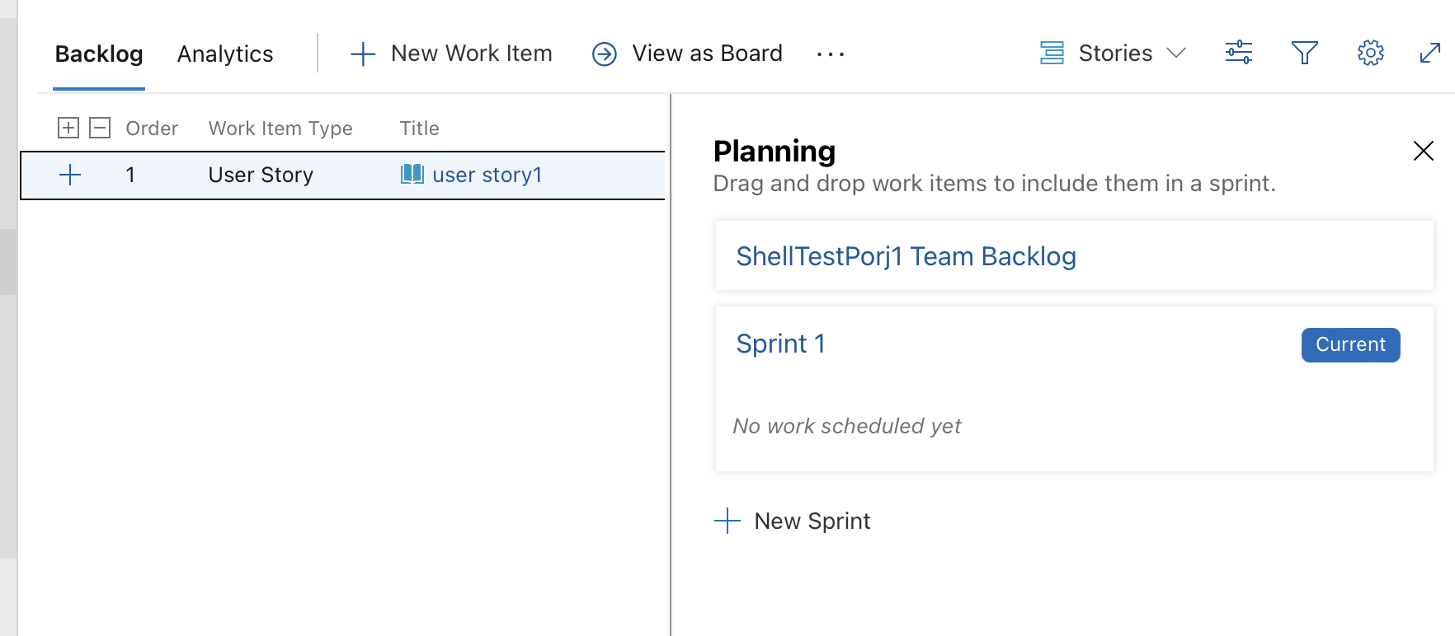
Challenge faced while implementing Learning 3
What were the challenges I faced while implementing Learning 3 and my plan to overcome them
Challenges: Applying theory to practice, adapting to new tools and techniques, and balancing agile methods with organizational structure.
Plan: Use peer learning for insights, conduct simulations for practical experience, and implement regular reviews to ensure alignment and adjustments.
[Add a graphic that provides evidence of what you did to overcome this challenge]

Slide 15

Action Plan

Slide 16
My Action Plan for this Week
Actions
Timeline
Status
Mentoring and Coaching: To assist with the real-world application of Agile techniques, offer continuing mentoring and coaching.
Visual Aids: To demonstrate important concepts and procedures, use Agile boards, charts, and visual models.
Getting Ready and Making Plans Determine participant challenges and skill levels in order to assess needs. Create Materials: Provide instructional materials that include activities and visual aids.
Created an Azure Agile account and put tasks, features, and epics into practice.

Slide 17

Learning is also Fun!

Slide 18
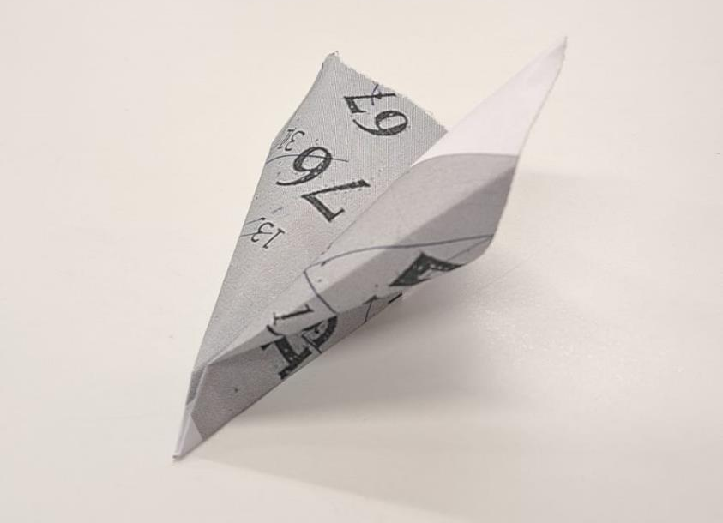
Learning is also Fun!
Please share how ”Your” learning was fun this week
Ice Breakers: We began with engaging activities to build rapport and ease into interactions.
Funny Moments: Colleagues’ dance performances added humor and helped lighten the atmosphere.
[Add a graphic or a picture of how you/your team enjoyed the new learning]

Slide 19

Summary
Importance of topics of upcoming week
Burnup Charts
Burndown Charts
Kanban
Connectivity of topics from current week
Development
Q/A
Staging
Production

Slide 20
Thank You

